Slide 1
MTE 204 – Project 2b
Anthony Pasquariello
Nancy Pham
Adam Rakoff
Antony Zhou

Slide 2
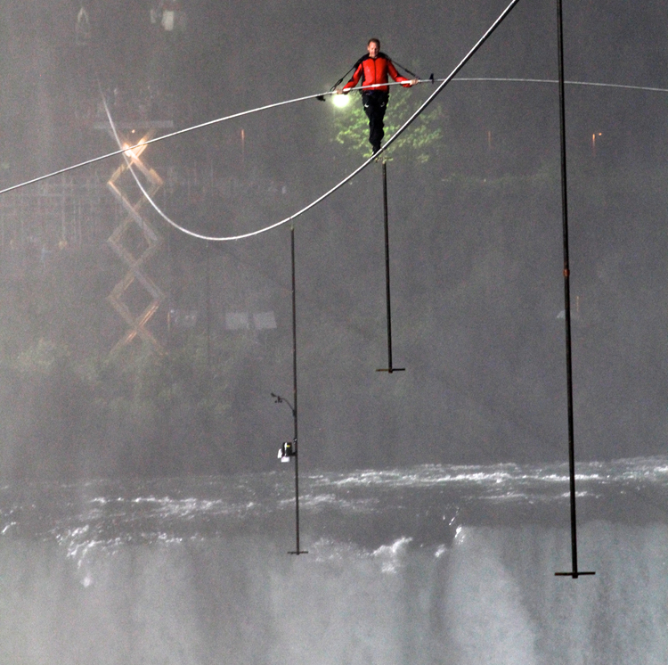
Overview
A high wire tightrope system is being modeled and analysed for this project.
The model will be a spring-mass-damper system which experiences bending .
Our goal is to verify that a tightrope walker needs to vary their pace in order to prevent oscillations from growing in amplitude
For validation, we researched Nik Wallenda’s crossing of Niagara Falls on a tightrope.

Slide 3
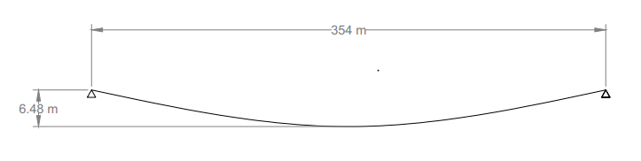
Our Problem
Notes:
-y-height is the same on both sides
-2-D problem

Slide 4
Niagara Problem
Notes:
-y-height is lower on the left side and higher on the
- Use pendulums to account for twist

Slide 5
Calculation Assumptions
Oscillations of the rope that are caused by the walker, walking at a constant pace represented as a sine wave.
Pendulums were added that helped reduce oscillations when walking across wire.
This model will be looked as a 2 dimensional problem ignoring wind and any other element that causes movement in the z-direction.
Twist of the rope was neglected, as it was solved by adding pendulums along the rope.
Wire started as a straight line without any slack for an initial condition

Slide 6
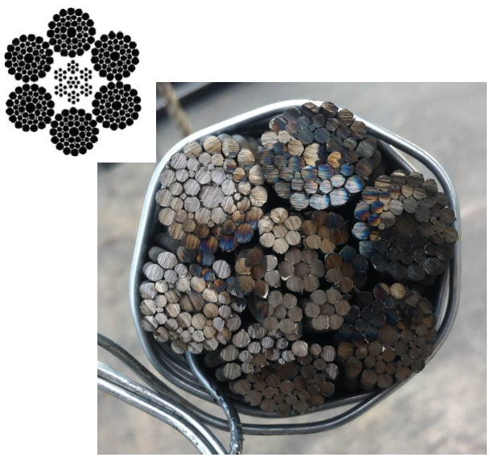
6x37 Classification Steel Wire Rope
6 Outer bundles and 1 inner bundle made of 7 sub bundles.
Moment of inertia was calculated as a very small value making torsion a serious concern.
Mass of wire between cranes is 3 844kg

Slide 7
Solving for our Problem
Reaching steady state would take a long time due to the oscillation in our rope.
The only way to reach equilibrium was to use very small time increments for a long time period.
To solve this problem, use an iterative way to get initial conditions.
Start with three nodes and get initial conditions
Interpolating between those three nodes, get an initial system for five nodes
Interpolating between those five nodes, get an initial system for nine nodes
Repeat until the desired number of nodes is reached

Slide 8
Matlab Graph Solution goes here

Slide 9
Validation
In 2012 Nik Wallenda walked across Niagara Falls on a 365m tight rope.
Tensile force in the wire was 62 500N and the wire stretched 3.96m.
To prevent torsion of the wire pendulums were added to the wire.
Nik did vary his pace during the crossing and according to observational data the oscillation did grow and subside however it was never severe.

Slide 10
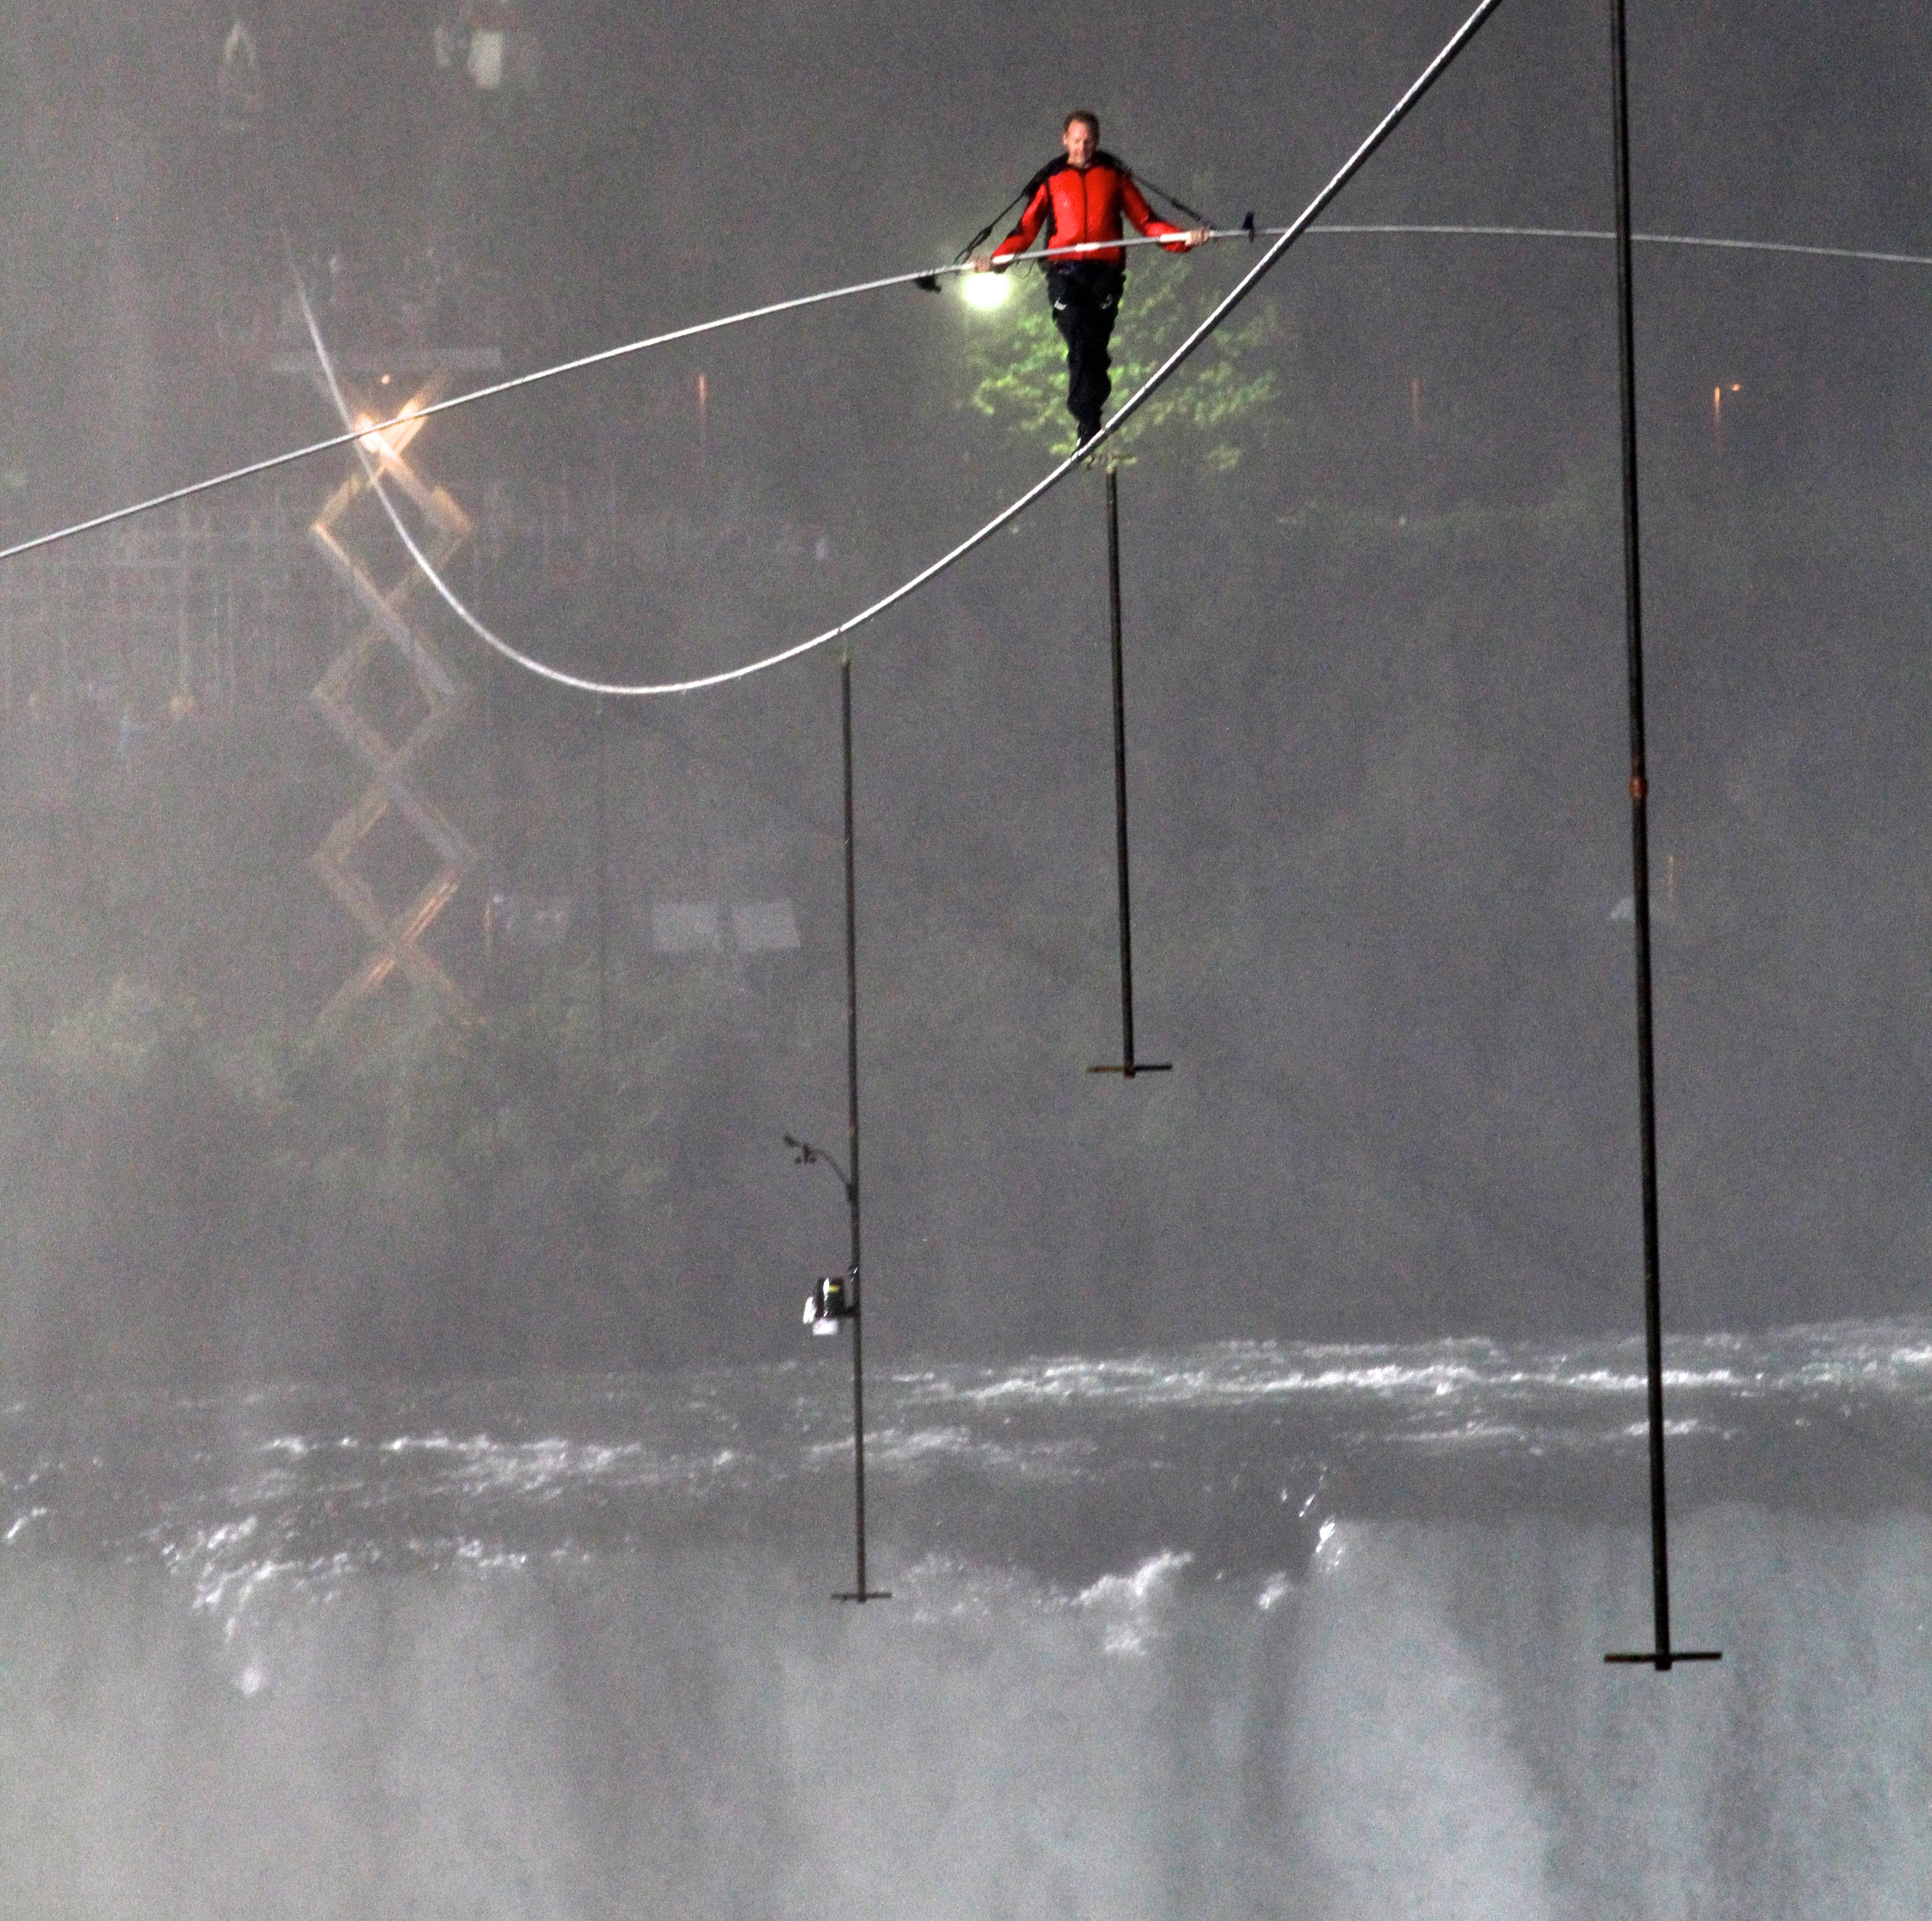
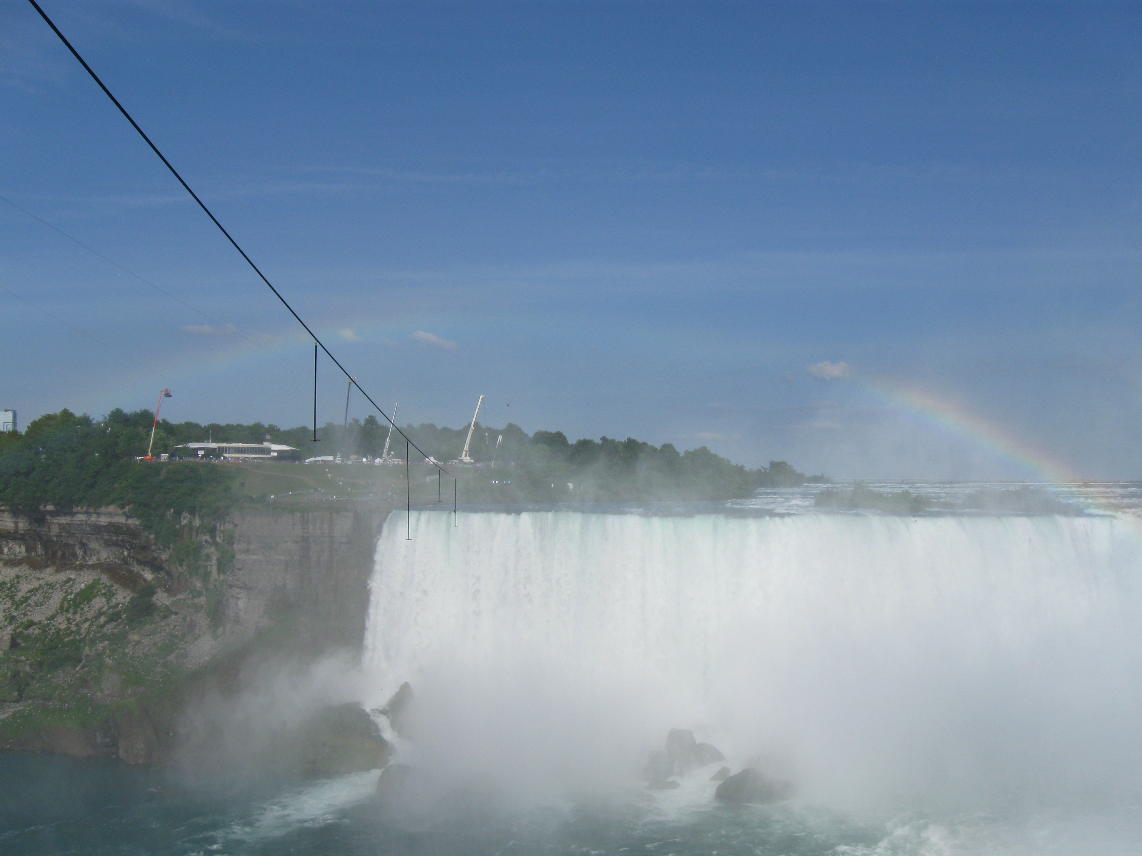
Final Tightrope Setup

Slide 11
Conclusions
Our model which is based on Nik’s walked

